Slide 1
Airbnb Global Short-Term Rentals and Reviews
Student: Felix Boaroog Atobiga
Course: Data Analytics
Location: Munich
Date: 7th June 2024
We use tech to connect human potential and
opportunity with dignity & humility

Slide 2
What is the Project About?
To understand the spatial distribution of listings to identify popular areas.
Understand the pricing distribution, availability, and guest satisfaction (reviews).
.
Understand the Airbnb rental market dynamics: Identify distinct segments within the rental market based on geographical location, room type, and pricing.
Purpose/Importance:
Provides valuable insights into the short-term rental market dynamics, benefiting hosts and renters.
It could be used by hosts to optimise listing performance and enhance competitiveness.
For renters, it can guide their accommodation search, ensuring a more informed and tailored experience
Gain insights into Airbnb's global short-term rental Listing and market dynamics.

Slide 3
Why I undertook this project?
Skills development and practical application.
Developing critical thinking and research questions skills

Slide 4
Exploratory Data Analysis
Source of Dataset – Kaggle
The price distribution for various Rental listings in different locations and neighbourhood across the globe.
The distribution of Room/Apartment Type (entire home/apt, private room, shared room) by Rental prices.
The geographical/spatial distribution of Rental listings worldwide.
Room/Apartment Types with the highest Monthly Average and Total reviews?
Availability listings of the various Room/Apartment types and those with higher listings throughout the year.
Top Neighbourhoods with high Room/Apartment availability listings across the globe and their spatial distribution.
Machine Learning Model used:
Binary Classification Model using Logistic Regression

Slide 5
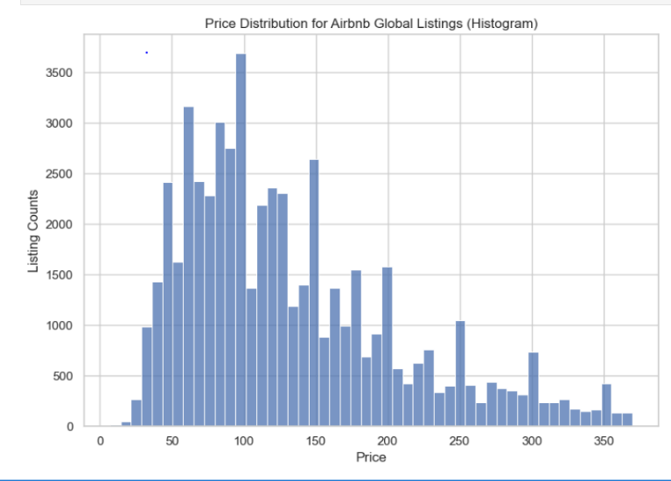
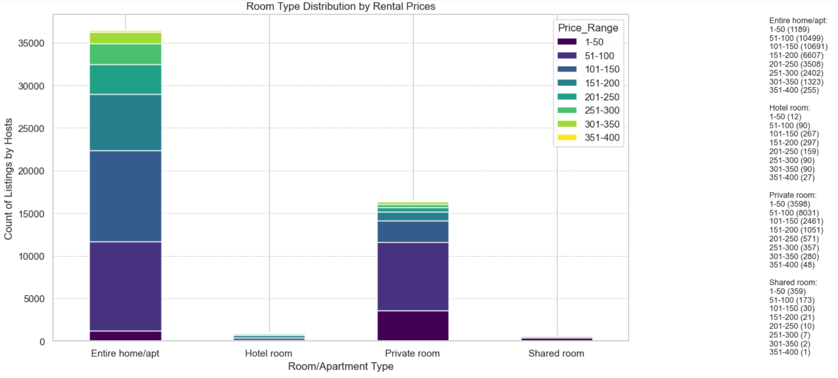
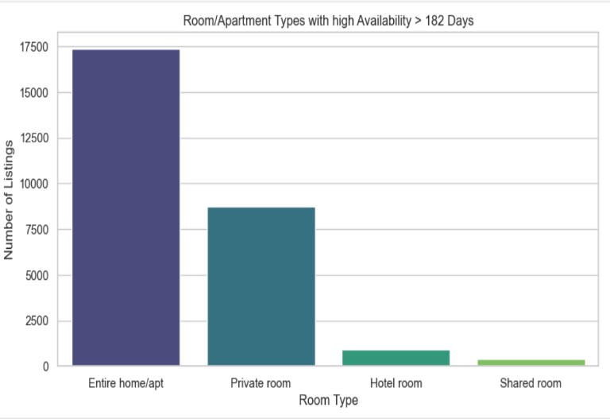
Results/Outcome

Slide 6
Challenges and Future steps
Time constraints made exploration with different data manipulation, visualisation methods and Machine Learning models impossible
Moving forward:
Explore how to use different Machine Learning models for classification and prediction.

Slide 7
Sources
ReDI Lecture Notes
https://www.w3schools.com/
https://www.kaggle.com/datasets/thedevastator/airbnb-global-accommodation-and-reviews
Google
ChatGPT
Perplexity AI

Slide 8
Thank you for your attention!

